Slide 1
2022 IREC Spaceport America Cup
Terrapin Rocket Team
Terpulence II Rocket Design
October 20, 2021
University of Maryland

Slide 2
Presentation Items
Team Overview
Terpulence II
General Rocket Overview
Aero-Structures
Recovery/Avionics
Payload
Testing Plan
Hybrid Motor Development
Combustion Chamber
Fuel
Injector
Oxidizer

Slide 3
Mission Statement
Compete in the Spaceport America Cup in the 10k ft COTS division and place among the best teams.
Increase the teams technical ability to compete in the more challenging divisions. Primary focus is on the SRAD hybrid motor division.
Promote rocketry and engineering principles to UMD students

Slide 4
Team Background
Began development of a hybrid motor in 2016
Successfully test fired scaled model of motor in 2019
Hybrid development stalled as a result of COVID-19
Competed in Spaceport America Cup 10k COTS in 2019, did not recover rocket
Competed in the Virtual Spaceport America Cup 10k COTS 2021, did not fly
Placed 20th of 36 teams
Member Experience
Two L2 certifications
Four L1 certifications

Slide 5
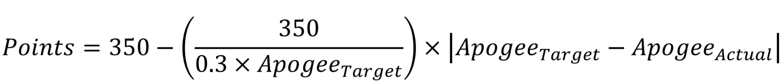
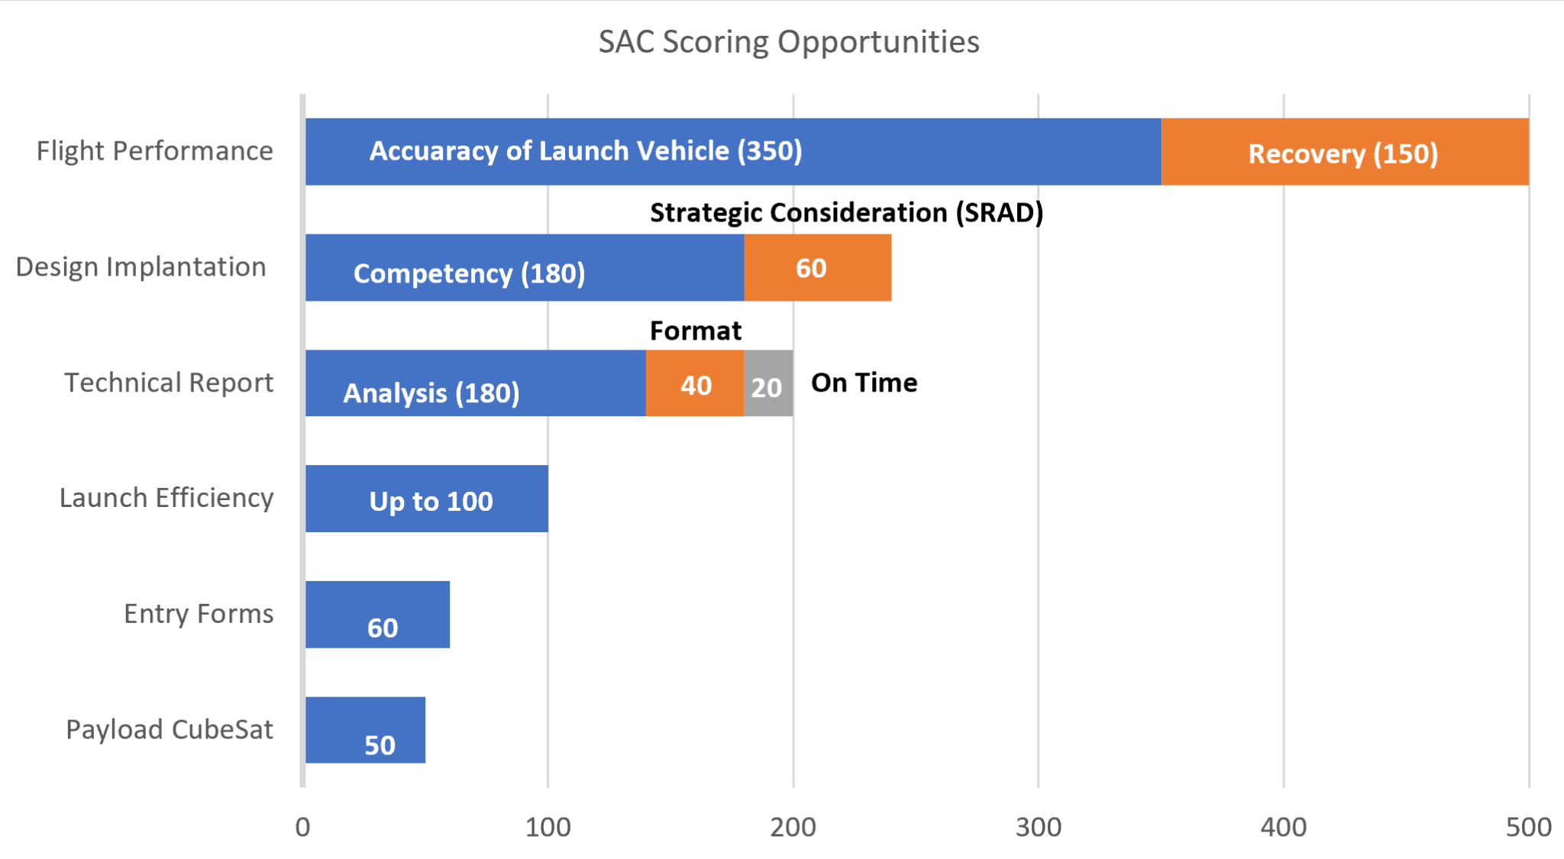
Competition Scoring

Slide 6
Project Timeline
Launch L1 Cert Rockets Oct 16
Test Rocket Launch
First Draft Technical Report
SpacePort America Cup!
PDR October 20th
Winter Break
L-Motor Rocket Test
September
October
November
December
January
February
March
April
May
June
First Look Fair
Sep 22&23
Finalize SAC Material
CDR End November
Finish Building Rocket
First Full-Scale Test
Start Semester
Focus on Fabricating
Second Full-Scale Test
6
Terrapin Rocket Team | Kick-Off Meeting

Slide 7
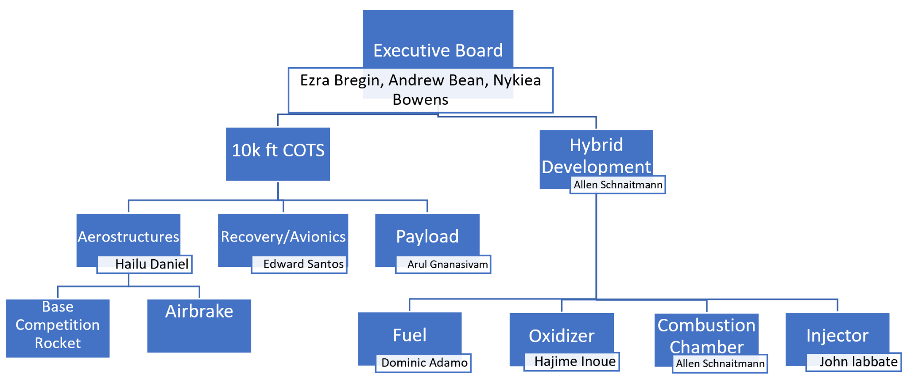
Team Structure

Slide 8
Presentation Items
Team Overview
Terpulence II
General Rocket Overview
Aero-Structures
Recovery/Avionics
Payload
Testing Plan
Hybrid Motor Development
Combustion Chamber
Fuel
Injector
Oxidizer

Slide 9
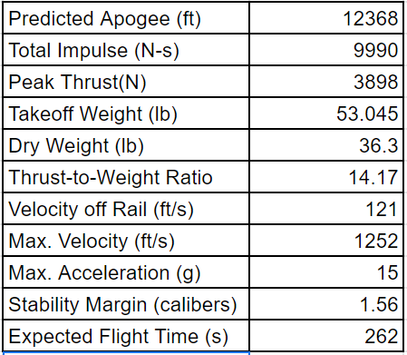
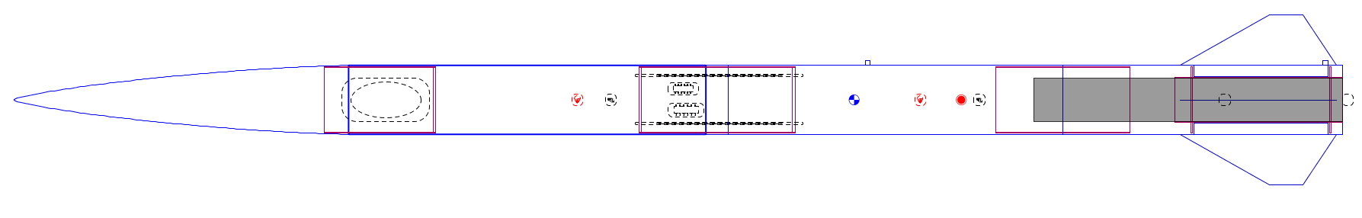
General Flight Characteristics
Notes:
Here is a table of some general characteristics of the rocket as well as a diagram from OpenRocket, a simulation program. Some important points to note are the off the rail velocity of 121 ft/s and a caliber of stability of 1.56. Both of these values show that we will be stable off the rail and should be flying straight.

Slide 10
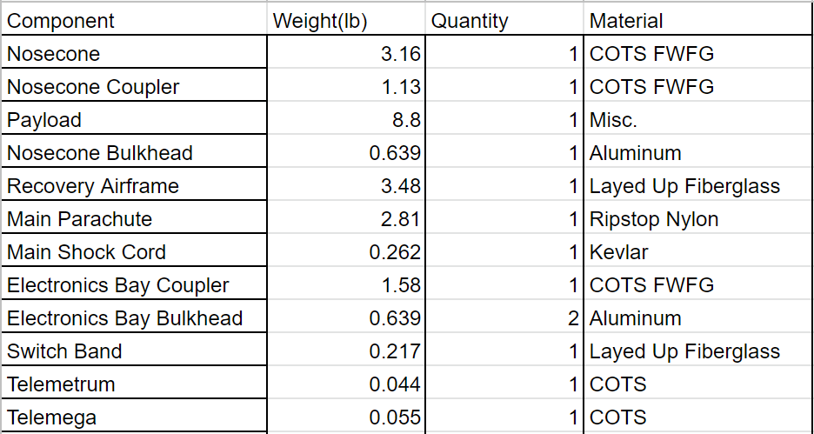
Component Masses and Materials

Slide 11
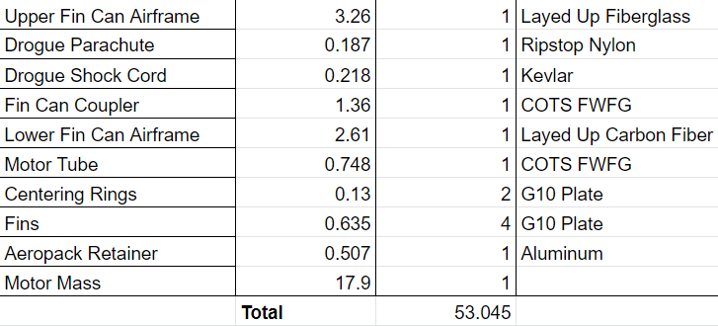
Component Masses and Materials
Notes:
Here is a parts list with most of the major components of the rocket as well as the materials that they are made from. Most of the airframe is made from fiberglass as it is RF transparent. This is necessary as we need to receive GPS data from the flight computers in order to find them. The only section made from carbon fiber is the lower fin can. Since this is where the force of the motor is transferred as well as the fins are connected, a stiffer stronger structure is beneficial.

Slide 12
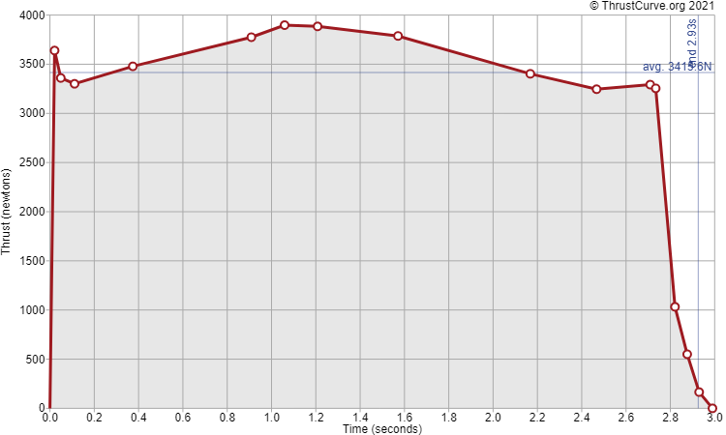
COTS Motor Selection
Cesaroni M3400-WT-P Motor
Loaded Weight (g) | 8108
Propellant Weight (g) | 4452
Burnout Weight (g) | 3342
Total Impulse (N-s) | 9994.5
Average Thrust (N) | 3421.1
ISP (s) | 228.92
Burntime (s) | 2.92
Notes:
For the motor, we have selected the m3400, which is a 98mm 4 grain motor. This motor is slightly oversized as it sends our rocket to around 12000 feet. This is to account for an off nominal launch angle as well as mass that will be added as the rocket is constructed. The high average thrust also helps with the 100ft/s off the rail velocity suggested by spaceport. The case that this motor fits in also works with many other motors from both cesaroni and Aerotech, so we have many options if we want to use something else.

Slide 13
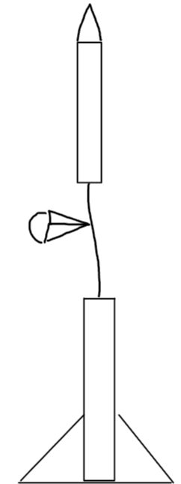
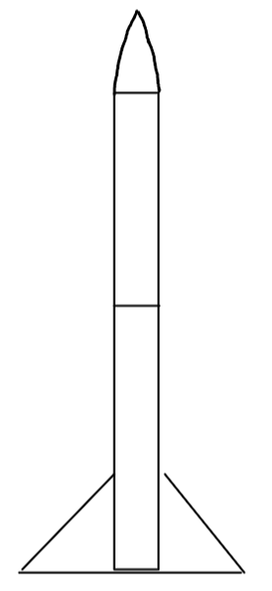
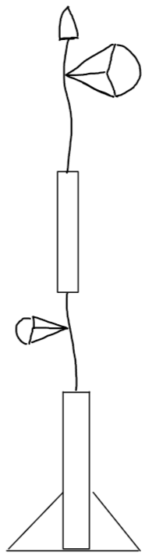

Concept of Operations
Drogue
Motor Ignition & Boost Phase
Unpowered Ascent Phase
Initial Separation and Drogue Deploy
Drogue Descent Phase
Nosecone Separation and Main Deploy
Main Descent Phase
Recovery Phase
3
Main
2
5
Drogue
1
Notes:
The rocket will have 7 phases of flight. At ignition, the rocket has its phase of powered boost. Following this, it coasts to apogee. At apogee, the rocket splits in half and deploys the drogue parachute. The rocket falls under drogue until around 1000ft at which point the nosecone is ejected and the main is deployed. The rocket then reaches the ground at which point it is found and recovered

Slide 14
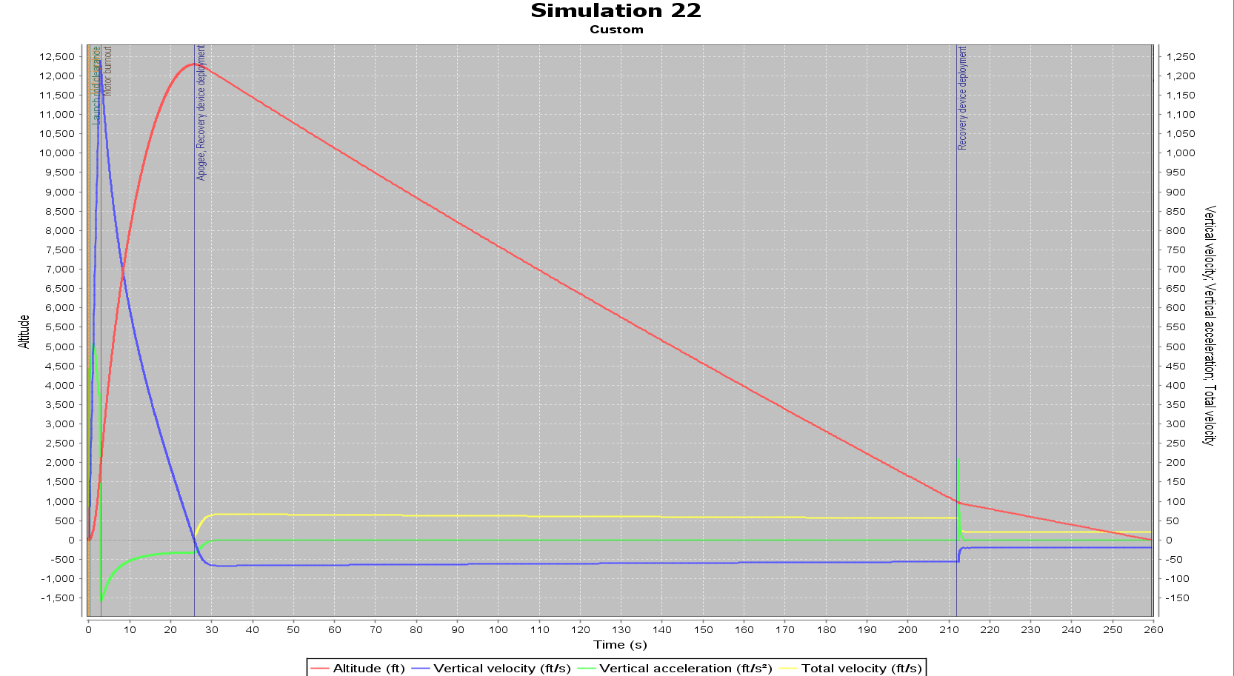
Flight Simulation
Ascent
Drogue Descent
Altitude (ft)
Main Descent
Time (s)
Notes:
This is a plot of our expected flight. We have the altitude in ft on the left vertical axis with vertical velocity and acceleration on the right vertical axis.

Slide 15
Presentation Items
Team Overview
Terpulence II
General Rocket Overview
Aero-Structures
Recovery/Avionics
Payload
Testing Plan
Hybrid Motor Development
Combustion Chamber
Fuel
Injector
Oxidizer

Slide 16
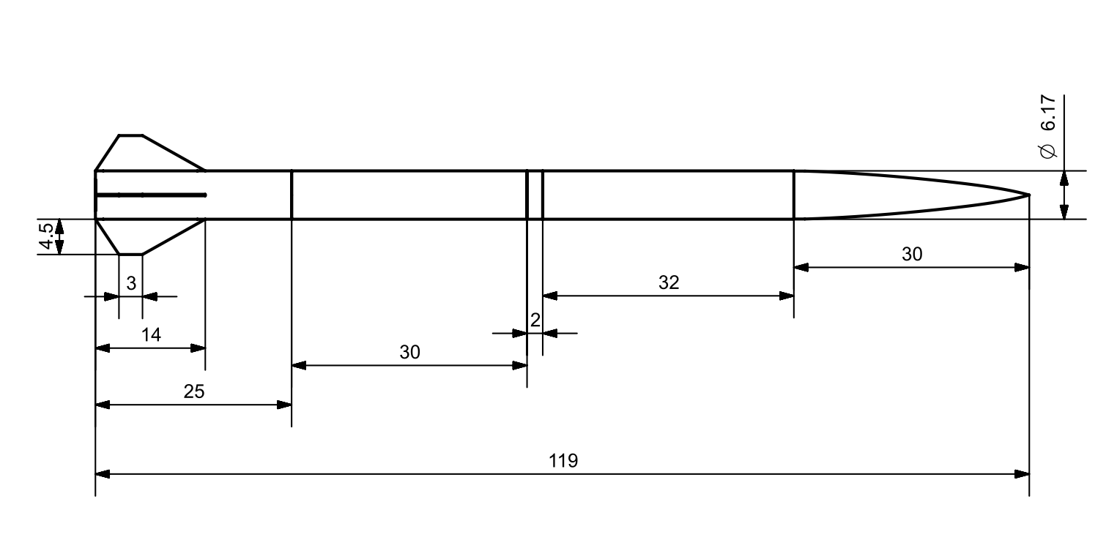
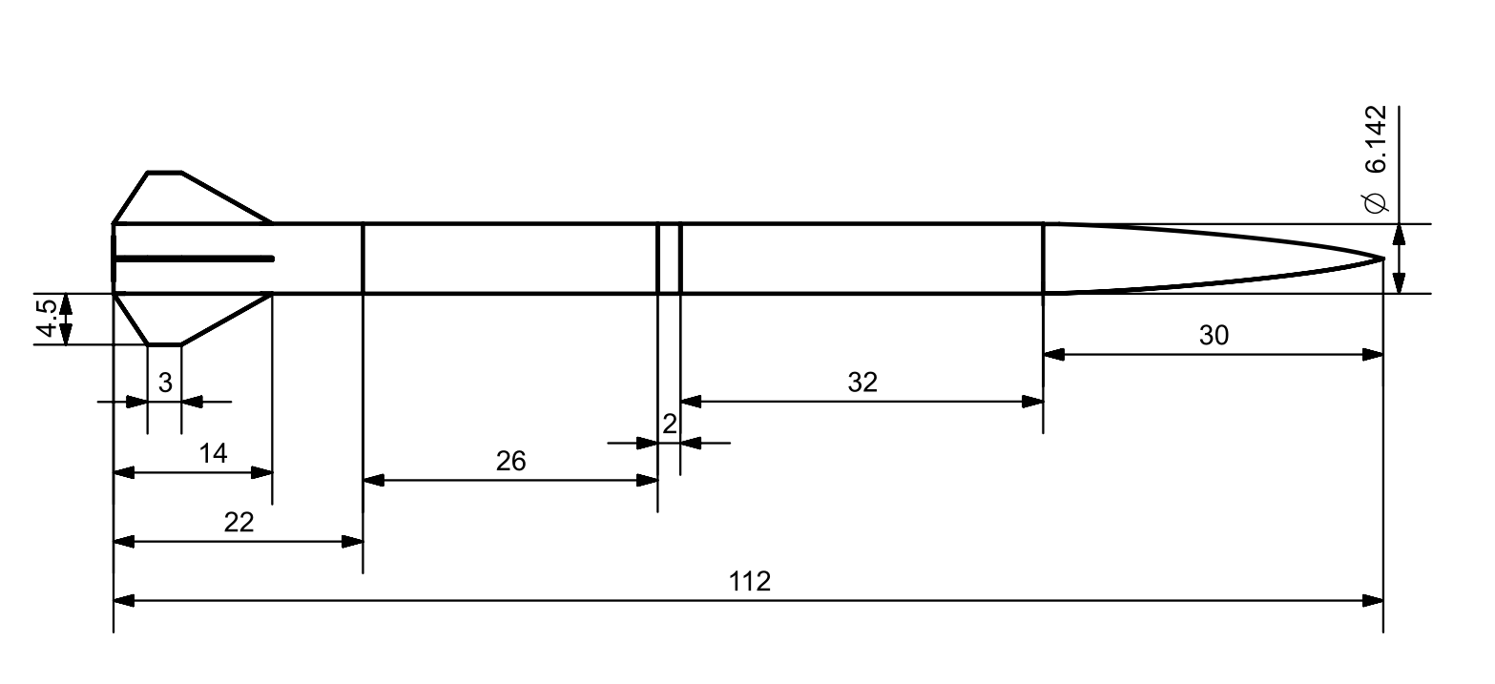
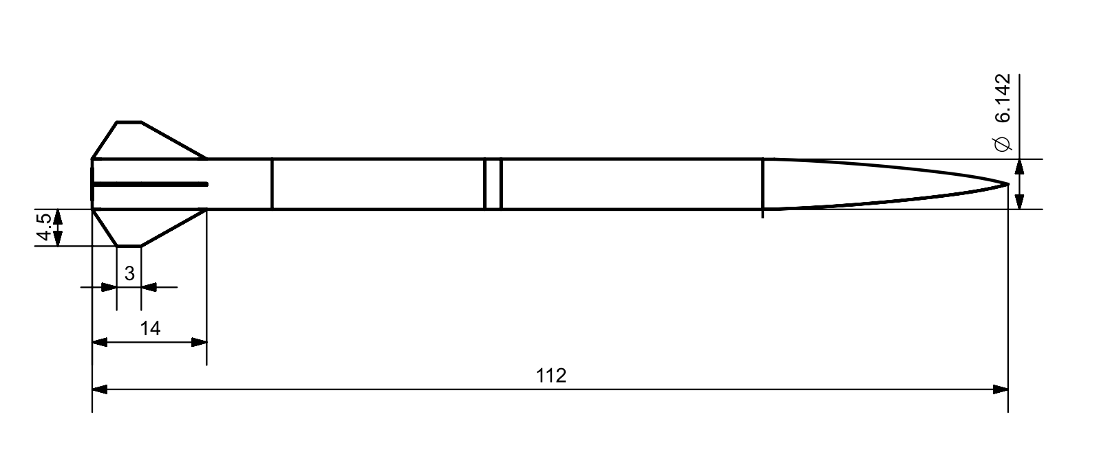
Major Dimensions
Switch Band
Lower Fin Can
Upper Fin Can
Recovery Section
Nosecone / Payload
Units: inches
Notes:
The main will be housed in the recovery section and the drogue will be in the fin can

Slide 17
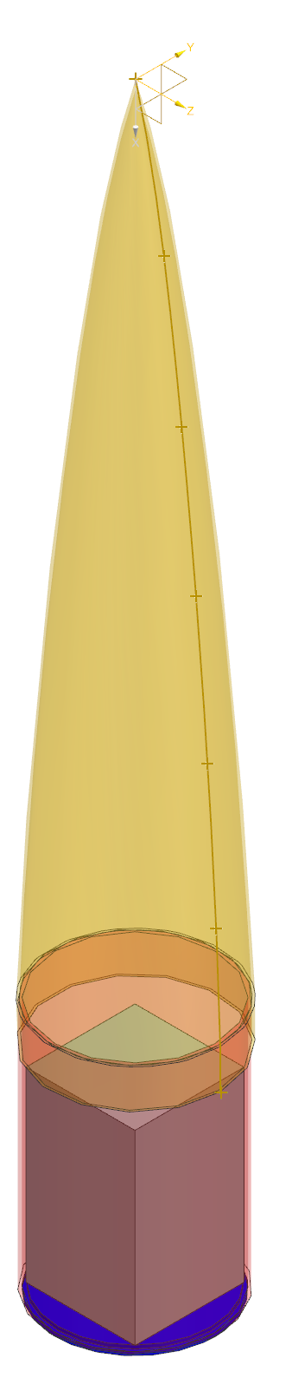
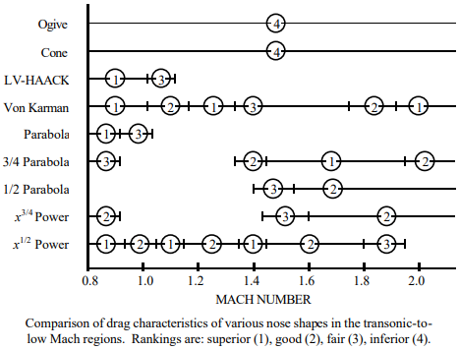
Nose Cone
COTS Fiberglass 5:1 Von Karman Nosecone
30” long cone with 6.17” diameter base
Bulkhead mounted to base of payload coupler
Working on alternative SRAD design
3D printed mold, fiberglass layup
https://www.irjet.net/archives/V7/i8/IRJET-V7I8605.pdf
Superior
Good
Fair
Inferior
Notes:
We are looking to obtain a fiberglass 5:1 length to diameter ratio Von Karman nosecone. The nosecone is 30” long and a little over 6” in diameter. The end of the nosecone fits onto a coupler that will house cubesat payload for competition which sits on top of a nosecone bulkhead. Additionally, we are working on an SRAD design where we create a 3D printed mold, do a fiberglass layup, and machine an aluminum tip for ease of manufacturing. We chose the Von Karman design because it is specially shaped to create minimum drag and performs best in the transonic regime.
-Designed the nosecone from the von Karman Equation, graphed it in Desmos, and created the curve in nx using a custom spline using points along the length of the curve.

Slide 18
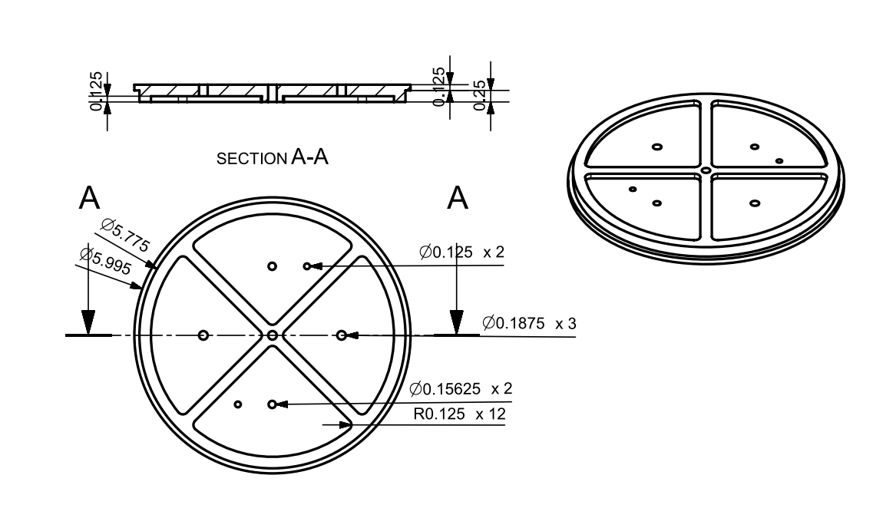
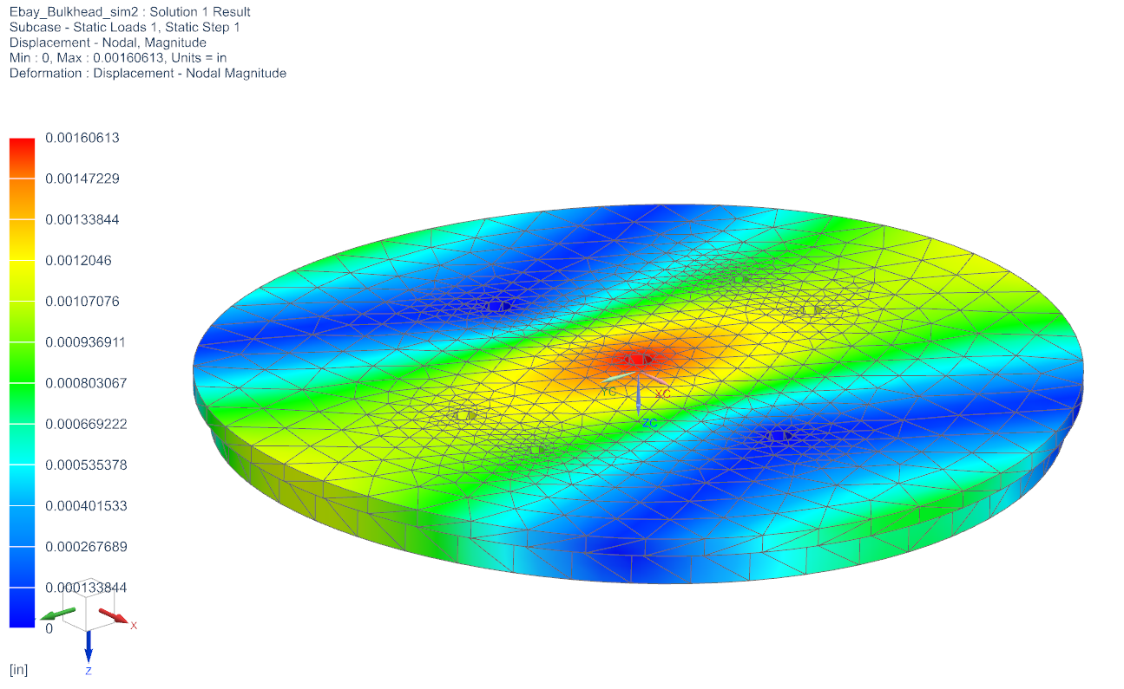
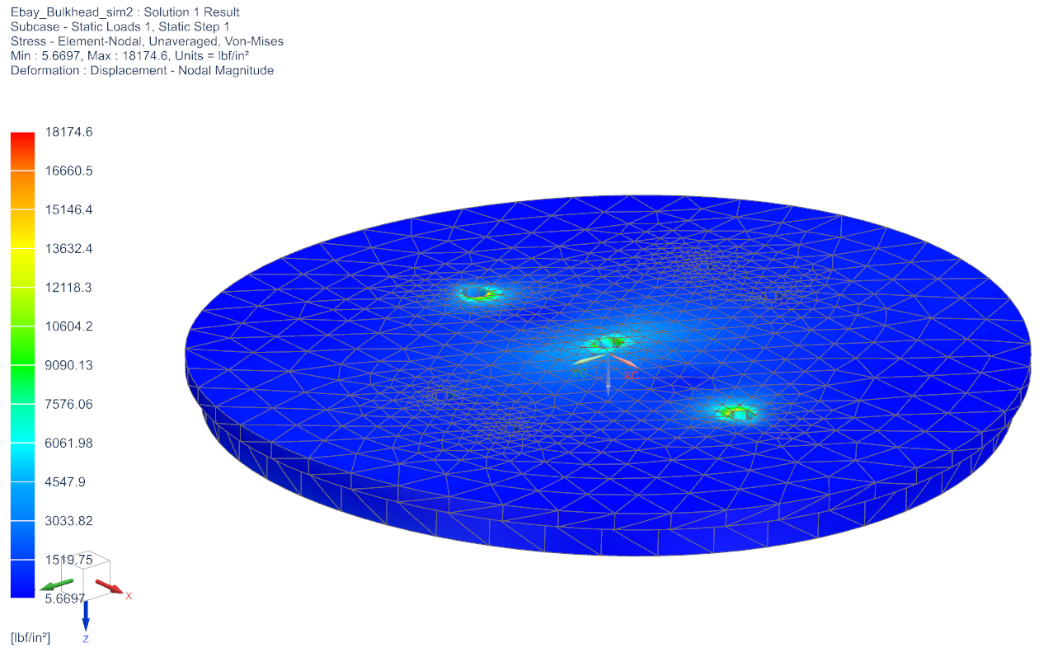
Bulkheads
CNC Milled 6061 Aluminum (ultimate tensile strength: 42 ksi)
Electronics Bay bulkheads anchored with 3/16” threaded rods
300 lbf applied to the center hole where an eyebolt is screwed into
Safety Factor: 2.33
Maximum Deformation: 0.0016 inches
Maximum stress: 18174.6 psi
Notes:
Purpose of adding ribs is to increase ridgidity without adding too much weight. Maximum displacement is 0.0016 inches occurring at the center hole where the eyebolt is screwed on. The maximum stress is about 18 ksi. Much of the stresses are applied to the threaded holes for the center eyebolt and the two threaded rods. The 300 lbf used to calculate the stress is much more than what we expect the eyebolt to actually experience.
Threaded holes and eyebolt hole are all 3/16 inches in diameter. The 5/32 inch (0.15625) holes are for charge wells. The ⅛ inch (0.125) holes are for the corresponding wires to the charges. The charge well and wire holes are next to each other.
The primary goal of this design is to simplify the manufacturing process. There are fewer parts to manufacture, and our bulkhead design is less complex than last year’s design.

Slide 19
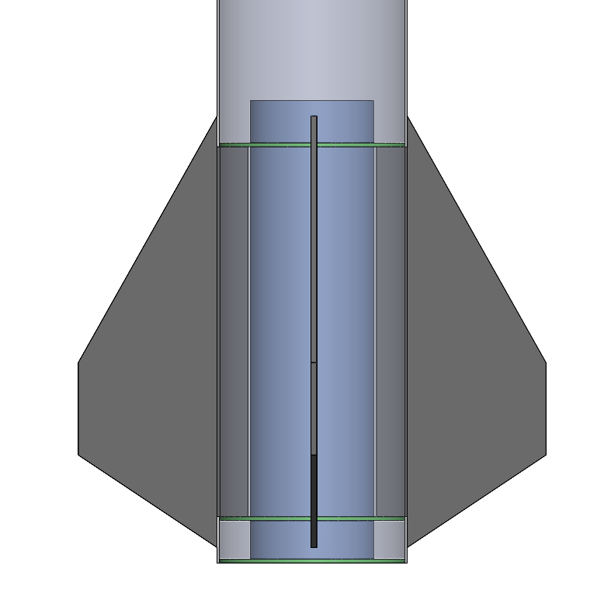
Fin Can
Laid-up carbon fiber airframe
98mm FWFG Motor Tube
Through-the-Wall (TTW) Fin mounting
Three centering rings (CRs)
Two CRs forward/aft of fin tabs
One CR at motor base
Internal Fillets - Injected laminating epoxy w/ chopped carbon
External Fillets - G5000 Rocketpoxy
Aeropack Motor Retainer on Bottom Centering ring
Recovery Harness epoxied to motor tube

Slide 20
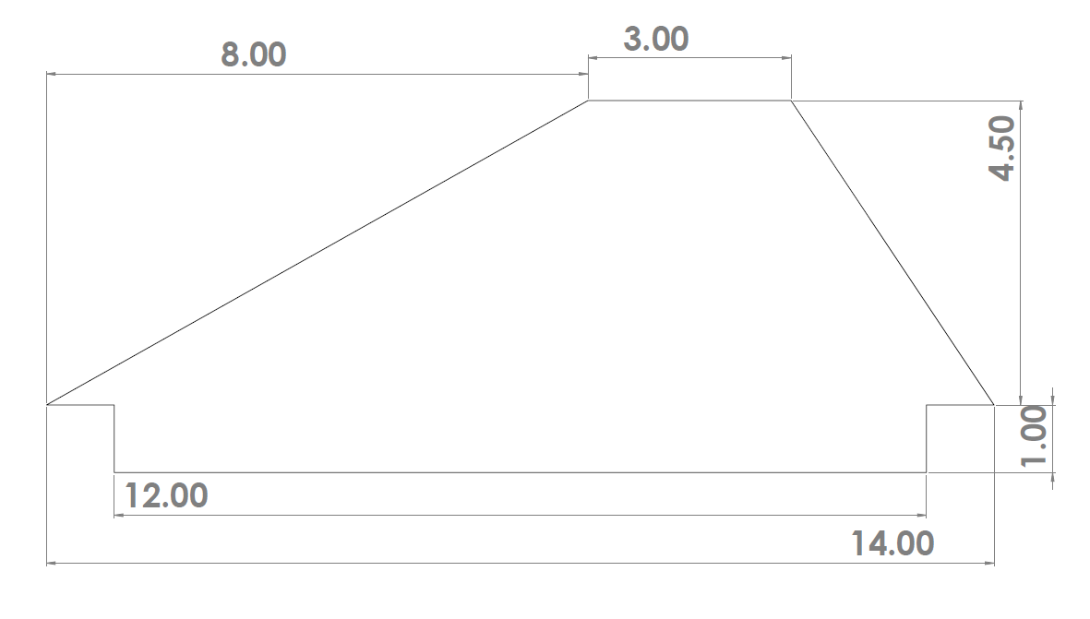
Fins
Swept, tapered
ꭥsweepback = 52.0°
Max. Velocity:
Umax = 1,230 ft/s
Est. Divergence Velocity*:
Udiv = 2,630 ft/s
Est. Flutter Velocity*:
4,140 ft/s
Max. AoA at Max Vel.*:
50.0°
*Estimates from AeroFinSim 5.7
Values in Inches
Notes:
Scale of values (green, yellow, red)
Stress concentration factors?
Fillet for tab join?
TESTING. (Transonic regime is tricky, very hard to predict/model...) Choose valuable info, throw out frequency analysis. Justify each bullet point. Find out where maximum stress occurs (tab corners?). Look into transonic analysis. Boundary layer analysis. Cite sources. Transonic, transonic, transonic. CP? CG? EA?

Slide 21
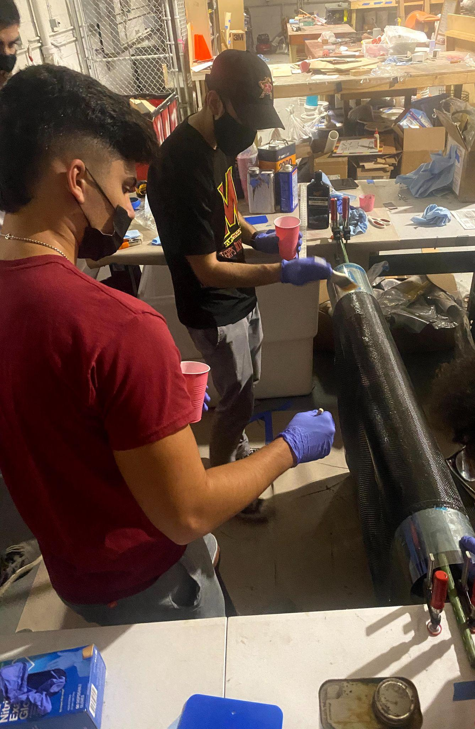
Composite Manufacturing
Airframe
25” Carbon Fiber Fin Can
30” Fiberglass Upper Fin Can Section
32” Fiberglass Recovery Section
Planned StressTesting
Fins
3/16” G10 Plate
SRAD Nosecone
Fiberglass sleeve over 3D Printed positive mold.
Aluminum Tip
Specs | Carbon | Fiberglass
Brand | FibreGlast | FibreGlast
Fiber Material | Carbon fiber | Fiberglass
Weave | 3k 2x2 Twill | Plain Weave
Weight | 5.7-5.9 oz/yd^2 | 5.5-5.8 oz/yd^2
Tensile Modulus | 33.6 MSI | 10.5 MSI
Strength | 610 KSI (tensile) | 70 lb/in (breaking)
Layer Thickness | .012" | .007"
Specs | Epoxy
Brand | West System
Epoxy Name | 105 Epoxy Resin
Hardener Name | 206 Hardener
Notes:
The airframe of the rocket is made up of 3 sections of carbon fiber and fiberglass made in a wet layup. We are limited by our mandrel size and cannot manufacture a tube long enough to make the fin can section in one piece. Because of this, it is being made in two separate parts and connected via a fiberglass coupler. We are also planning on testing our airframes in both compression and tension. This will help us determine our safety factors and optimize our layup process. We are also working on making our own fiberglass nosecone. We recently acquired access to a large 3d printer and plan to print a positive mold and then layup fiberglass sleeve on top.

Slide 22
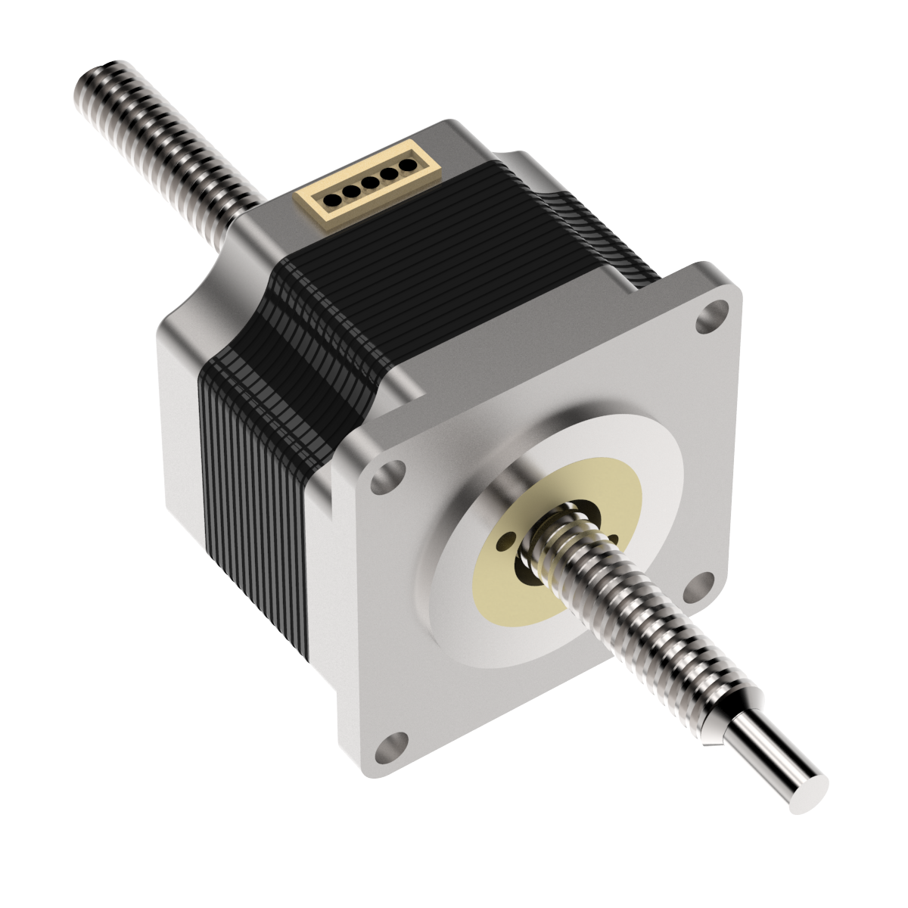
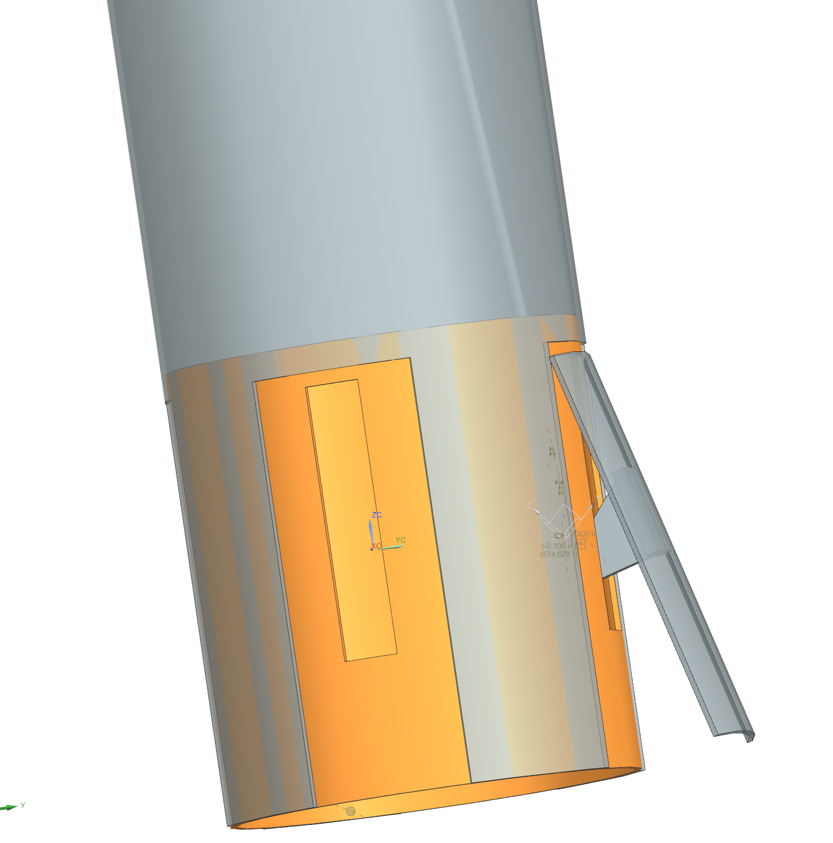
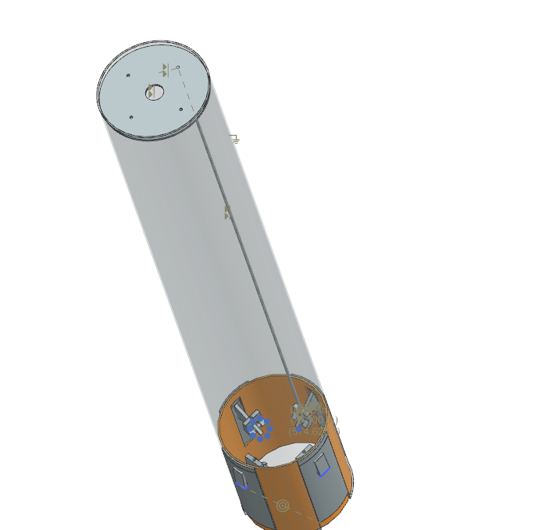
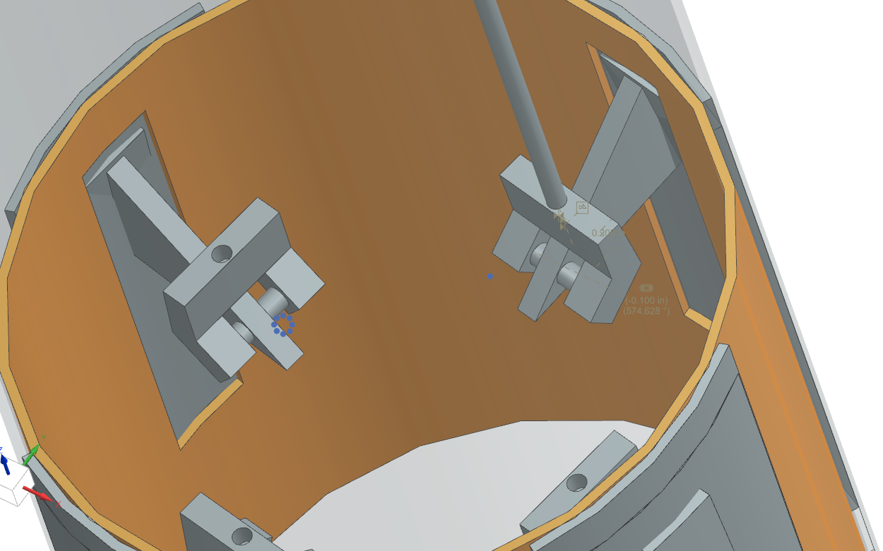
Air brake Design
Linear actuator pushes plate above motor casing
Rod pushes hinges outward causing flap to protrude outward
Actuator controlled by control design in flight computer
Flap will fluctuate in and out to slow down rocket as desired
Notes:
-The Pivot Screw will attach the brake flap to the gear that deploys the flaps as well as to the mounting plate

Slide 23
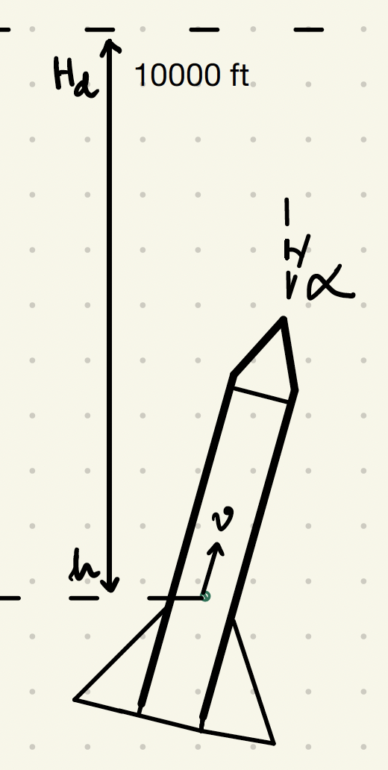
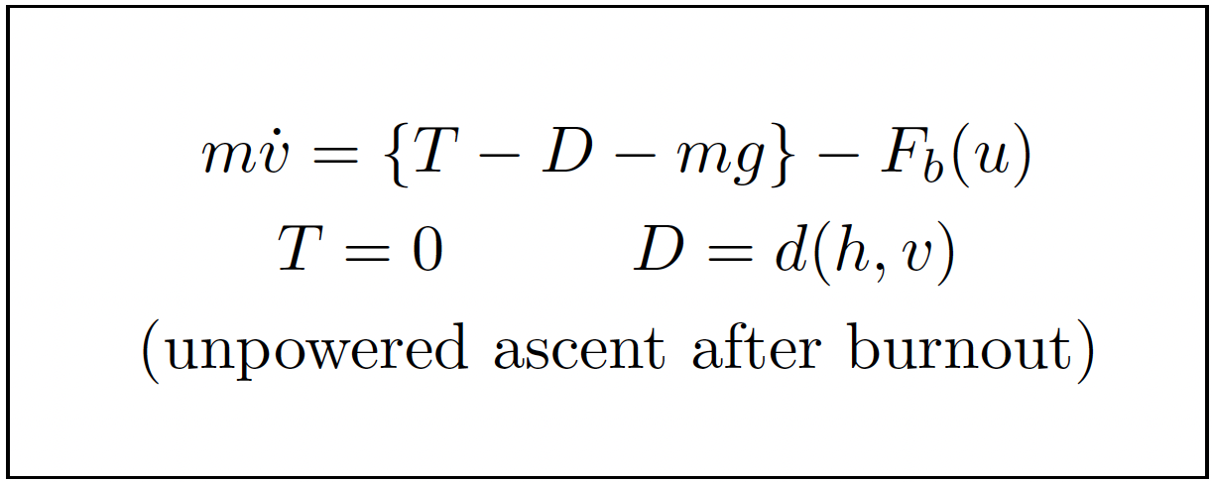
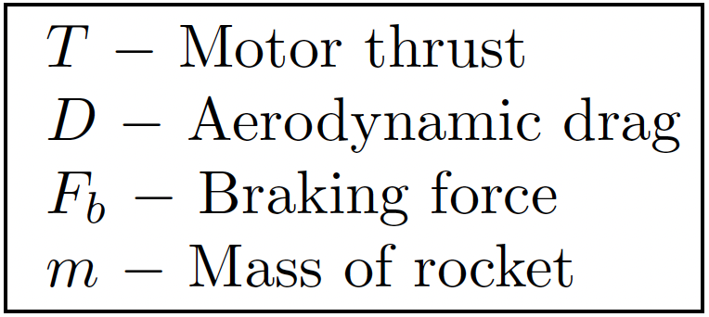
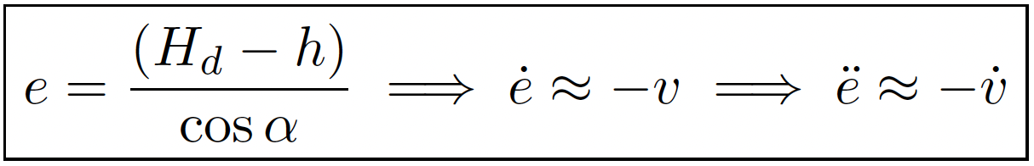
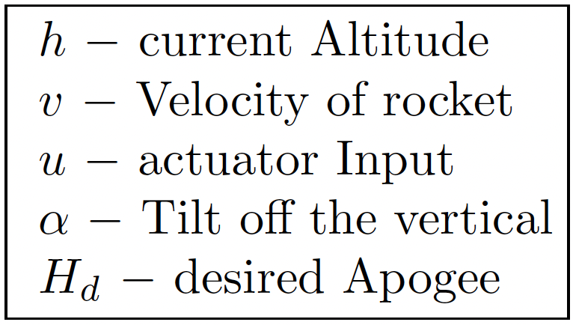
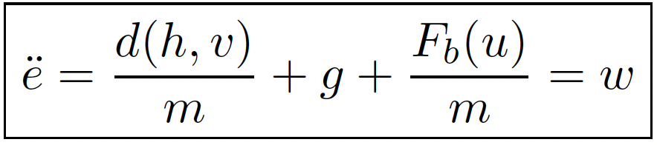
Air Brake Controller Design

Slide 24
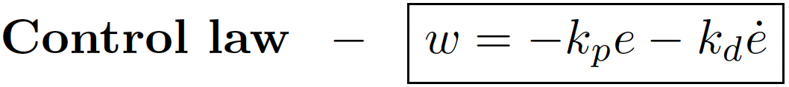
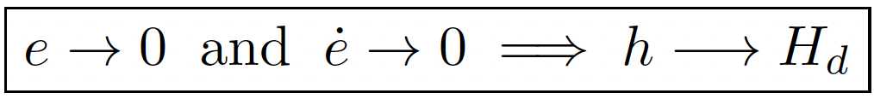
Air Brake Controller Design
Feedback Linearisation Controller
PD controller with transformed input, w
An added Integral action will ensure zero tracking error and robustness

Slide 25
Controller Design Considerations
Stability of closed-loop system
Ability to track setpoint without zero steady-state error
No overshoot!
Settling time within time-to-apogee
Robustness
Disturbance rejection
Noise cancellation

Slide 26
System Modelling and Validation
Aerodynamic drag modelling - d(h,v)
CFD using STAR-CCM
Wind tunnel tests
Air-density - lookup table based on ISA
Model brake-force - F_{b}(u)
Parameter identification from CFD and field tests
Identify actuator model
Actuator displacement → flap angle → brake force
Tuning controller gains
Validate our aerobrake system on a smaller 4in rocket
Test deployment and our finite-state automaton
Performance analysis

Slide 27
Presentation Items
Team Overview
Terpulence II
General Rocket Overview
Aero-Structures
Recovery/Avionics
Payload
Testing Plan
Hybrid Motor Development
Combustion Chamber
Fuel
Injector
Oxidizer

Slide 28
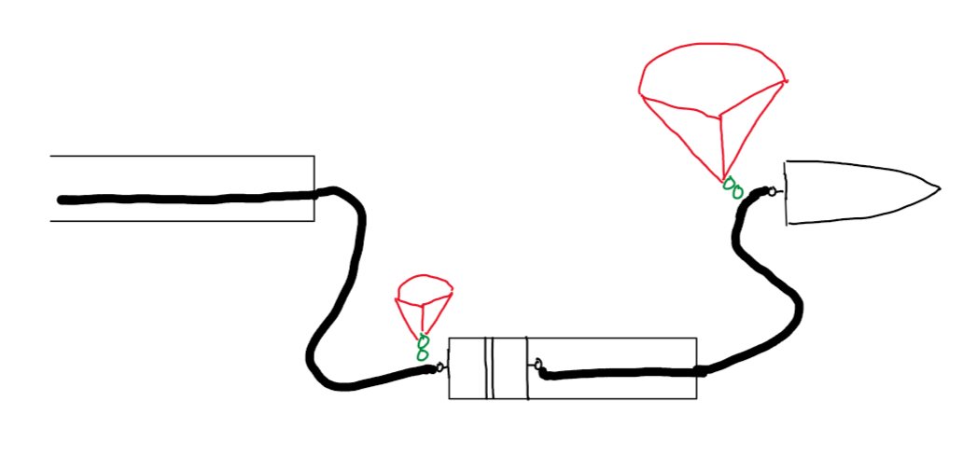
Recovery System Overview
Main Parachute
Electronics Bay
Shock Cord to Motor Mount and Motor
Drogue Parachute
Notes:
Here is a diagram of our recovery harness. The lower shock cord is attached to both the motor tube and motor casing as well as the electronics bay. This double lower connection provides some redundancy for the possibly high velocity drogue deployments. The main shock cord is attached to the electronics bay and to the nosecone bulkhead. Cords are connected via quick links and each parachute has a swivel link in order to prevent tangling.

Slide 29
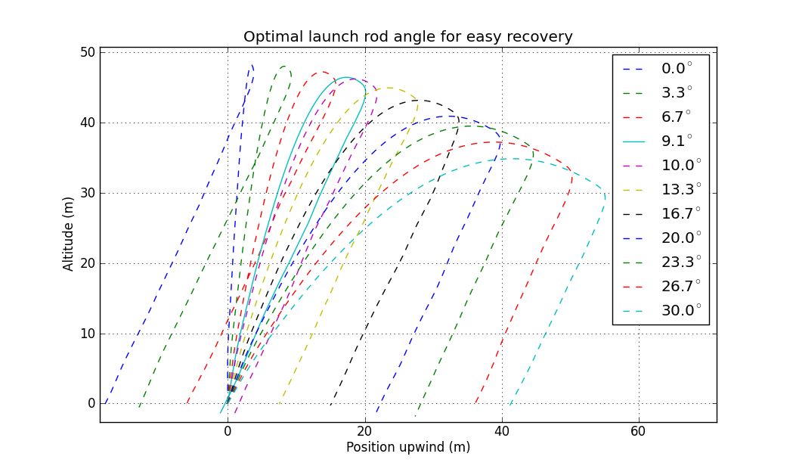
Monte Carlo Simulation
Developing method of predicting landing position relative to launch
Utilising Open Rocket’s API
Input a tolerance for a number of variables
Run multiple simulations simultaneously to produce landing position data
Example
Notes:
We are also working on running monte carlo simulations within open rocket. By randomizing the inputs for multiple variables, we can find launch conditions that will ensure the rocket will be stable off the rod. This means that we could utilize a slower off the rail velocity or stability caliber.

Slide 30
Recovery System Component List
Main Parachute | SkyAngle Cert-3 XL, 17-25 fps descent rate for 32.6-70.6 lbs
Drogue Parachute | 30” Fruity Chutes Drogue, estimated 76.32 ft/s descent rate
Main Shock Cord | 25 ft. 7/16” Kevlar Shock Cord, 5300 lbs. rated (OneBadHawk)
Drogue Shock Cord | 35 ft. 7/16” Kevlar Shock Cord, 5300 lbs. rated (OneBadHawk)
Quick Links | 3/8 in. Zinc Plated Quick Link, 2200 lbs. rated (McMaster-Carr)
Swivel Links | 3/8 in. Galvanized Steel Swivel 2200 lbs. rated (McMaster-Carr )
Eyebolts | 3/8 in. Zinc Plated Steel Eye Bolts, 1400 lbs. rated (McMaster-Carr )
Notes:
Here is a list of the major components of the recovery system. Currently, our drogue is a little oversized. The actual descent rate will most likely be slower because of drag from the airframe, so we will probably end up making the parachute smaller to reduce drift. The spaceport rules also forbid stainless steel parts in any structural capacity, so that is why connection points are zinc plated or galvanized.

Slide 31
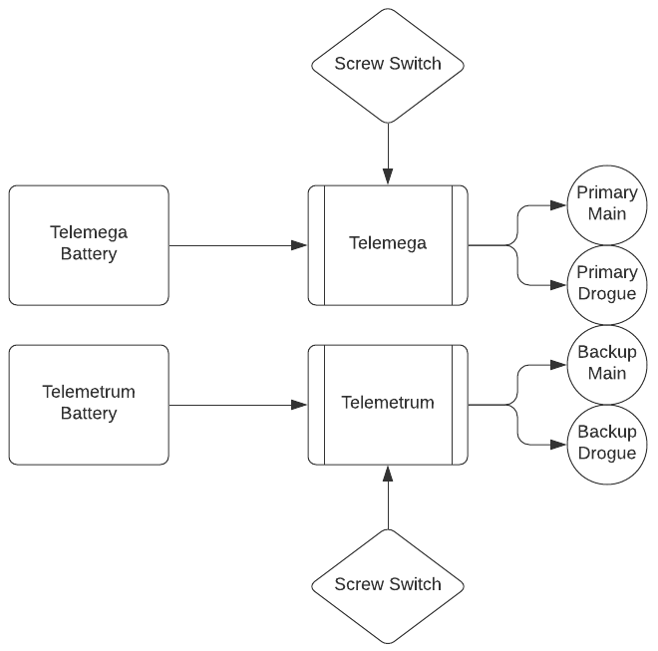
Recovery System Block Diagram
Notes:
Each flight computer has its own battery and switch. The telemega acts as the main flight computer with the telemetrum as backup. Each is connected to its own pair of drogue and main charges.

Slide 32
Deployment Scheme
Black Powder Deployment
One main and one drogue charge is connected to each flight computer.
The primary drogue charge is fired at apogee with the backup 2 seconds later
The primary main charge is fired at 1000 ft with the backup at 800 ft
Estimated Charge Sizes (estimated 3F BP substitute)
Primary Main Charge: 5g
Backup Main Charge: 7.5
Primary Drogue Charge: 5.5
Backup Drogue Charge: 8.25
Shear Pins
Both Sections will be held by 2 4-40 shear pins to prevent premature separation
Parachute Packing
Each parachute will be packed with the “burrito” method in a nomex blanket
Notes:
For deployment, we will be using black powder. This is the most common method for parachute deployment in high power rocketry and is highly reliable. The drogue backup and main backup will both be slightly delayed in order to prevent overpressuring the rocket. The backup charges are also 1.5x the primary charges as another redundancy measure. In order to prevent premature separation of the fin can or nosecone, both will be held in by nylon screws which will shear once the ejection charges go off. The parachutes will be packed in nomex blankets to protect them from the heat of the ejection charges as well as contain them within the tube.

Slide 33
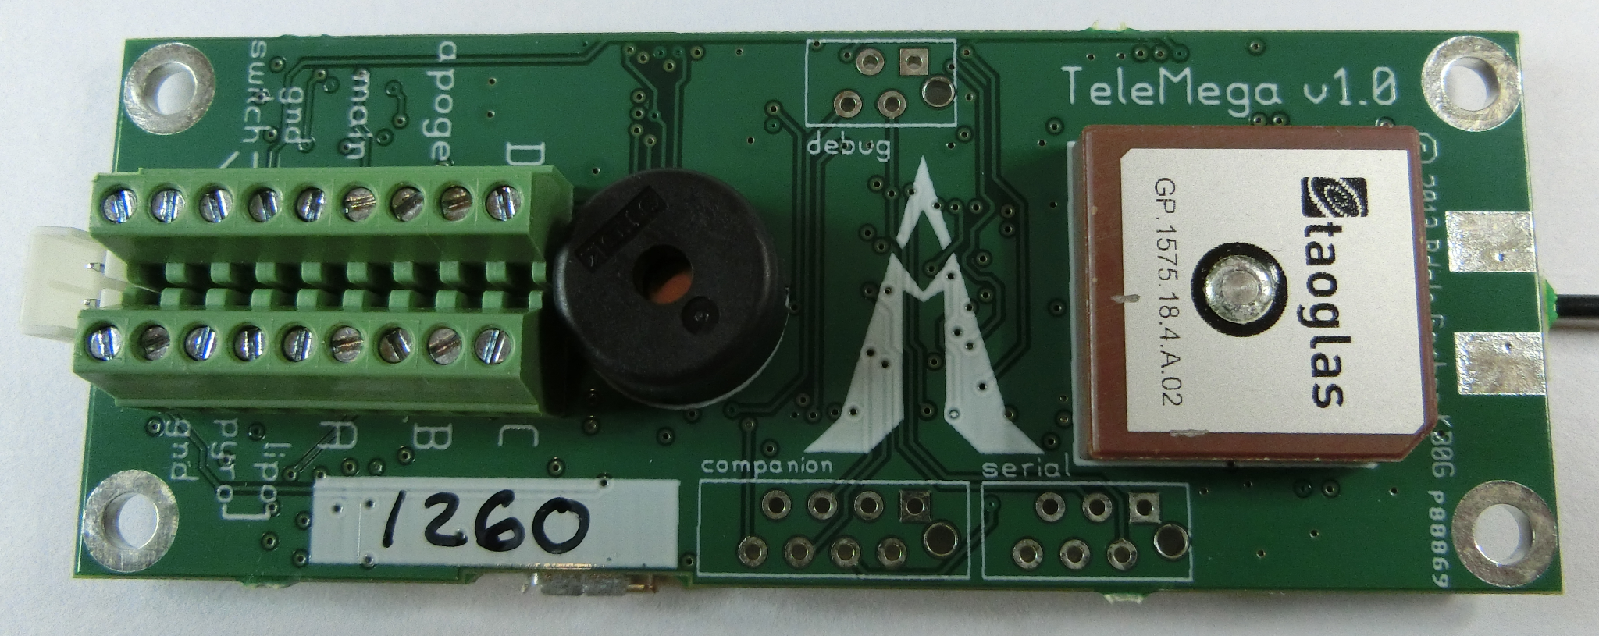
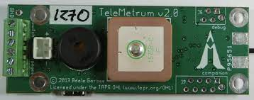
Flight Computer Capabilities
TeleMega and Telemetrum
Controls deployment of Drogue and Main
Live telemetry of flight data and GPS tracks
Flight data recorded for post flight review
Mounted on sled in electronics bay coupler
Notes:
Both flight computers have fairly similar feature sets, most importantly controlling deployment events and GPS location. They will both be mounted on a sled within the electronics bay and be activated by screw switches.

Slide 34
Recovery System Testing
Flight Computer Validation
Metal bulkheads and threaded rods may cause interference
Telemetry testing at range internally and externally
Test flights in competition configuration
Deployment Testing
Ground deployment testing of both test rocket and competition rocket charges
In flight testing of computer deployment and parachute packing methods
Notes:
Because the flight computers will be surrounded by metal bulkheads and threaded rods, testing has to be done to verify operation of the telemetry with the possible interference. This can be done on the ground, but flight testing must be done in order to verify this at range.
Deployment testing will also be done on the ground in order to verify that the charges can separate the rocket and shear the nylon screws.

Slide 35
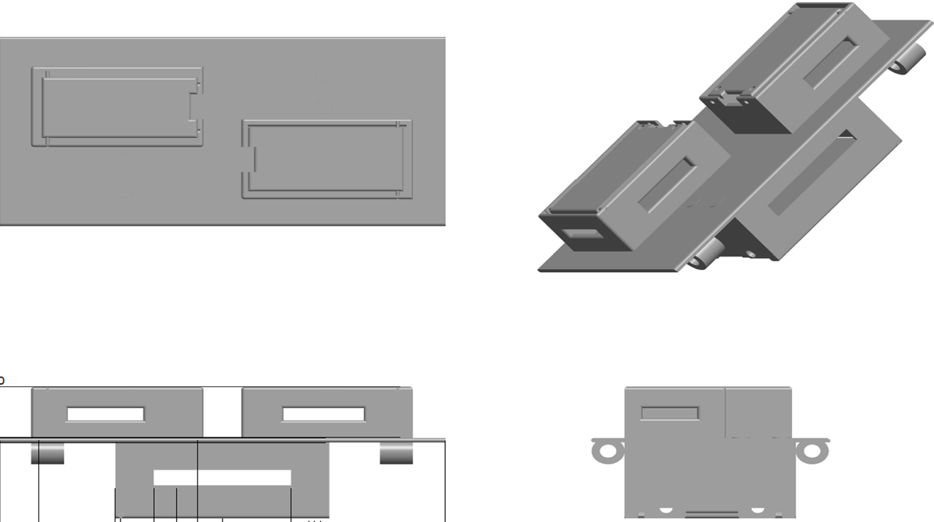
Electronics Bay
Notes:
Here is a preliminary design of the electronics sled. This will slide on the the two threaded rods in the electronics bay and will house the flight computers, batteries, and SRAD flight computer.

Slide 36
SRAD Flight Computer
Capabilities
Reliable sensor data acquisition and logging
GPS Tracking
Programmable pyro events
RF transmission
Aerobrake control
Valve control- for hybrid motor
Notes:
For the SRAD flight computer, we want to have all the features of standard rocket flight computers, as well as control of other subsystems on the rocket. This includes the airbrakes and the hybrid rocket engine.

Slide 37

Flight Computer Diagram
MTK3339
(GPS)
Raspberry Pi Zero
(Microcontroller)
Sensirion SHTC3
(Thermometer & Hygrometer)
SX1278
(Transceiver)
BNO055
(IMU)
BMP388
(Barometer & Altimeter)
Data Transmission via 433 MHz Radio
Ground Computer
SX1278
(Transceiver)
Raspberry Pi Zero
(Microcontroller)
USB
Notes:
Here is a basic diagram of the planned devices and sensors that will be connected to the flight computer. In addition to gps, altitude, and acceleration data, the flight computer will also have live telemetry to a ground station.

Slide 38
Presentation Items
Team Overview
Terpulence II
General Rocket Overview
Aero-Structures
Recovery/Avionics
Payload
Testing Plan
Hybrid Motor Development
Combustion Chamber
Fuel
Injector
Oxidizer

Slide 39
Payload Mission
Design a payload capable of inflating and releasing a blimp with scientific sensors from the rocket while it descends with the drogue parachute.
This will act as a testbed for possible long term in-atmosphere data collection projects on planets like Venus or Jupiter
Blimp will not be deployed during the competition launch this year.
The technical issues associated with separating a payload from the rocket are too great to accomplish before the competition, so the payload will stay in the nose cone
To ensure the payload is capable of deploying the balloon, a ground launch will be conducted
Notes:
Not deployed during competition to avoid interfering with rocket
The blimp could be used to conduct long term data collection in the atmospheres of planets like Jupiter or Venus.
Instead of deploying the blimp from the nose cone, it's going to simulate inflation, data measurement, and deflation inside the nose cone.
Final

Slide 40
Initial Concept
Payload will be housed in the nosecone
Major Dimensions: 13.2 cm x 13.2 cm x 44cm
Lifting gas = Helium
Max blimp weight = 1.2lb
Pressure vessel holds 2.5L at 2900 psi
For the competition launch a lower pressure CO2 system will be used
Scientific sensors include a camera, temperature sensor, pressure sensor, and humidity sensor
Nose cone connection point
Balloon
Data transfer pins
Blimp frame
Servo
Tubing
Inflation solenoid
Control relay board
Battery
Pressure regulator
Pressure vessel
Notes:
2900 psi was estimated using the highest expected mass (1.2lb) of the blimp. The final psi and mass will be lower.
Final

Slide 41
Presentation Items
Team Overview
Terpulence II
General Rocket Overview
Aero-Structures
Recovery/Avionics
Payload
Testing Plan
Hybrid Motor Development
Combustion Chamber
Fuel
Injector
Oxidizer

Slide 42
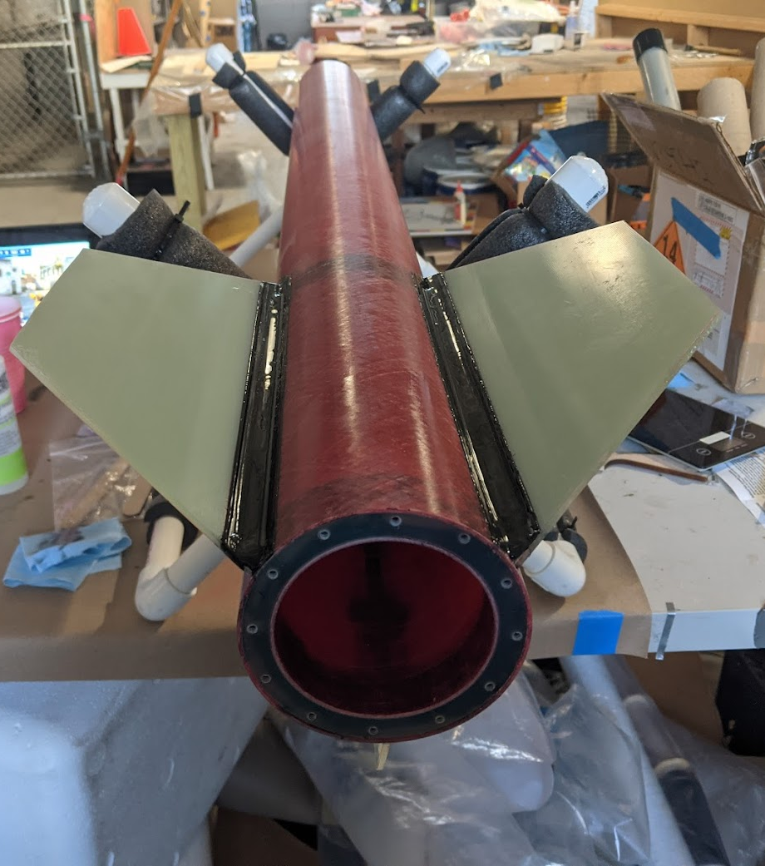
Test Rocket
4” Fiberglass Rocket
Testbed to practice construction and recovery techniques
Mostly COTS parts to speed up assembly
Designed to fly on J-L motors
Monthly launches at MDRA until full rocket is complete
Notes:
While we are building the full competition rocket, we want to have a testbed in order to practice integration of all of our systems. This is a full fiberglass rocket made of mostly commercial parts so that it could be put together quickly and easily. It was used in order to practice building techniques, especially for the fins. This is designed to fly on J-L, or even M motors and will allow us to do high altitude test flight to practice location and recovery. We will be hopefully launching this monthly until the full competition rocket is ready.

Slide 43
Testing Plan
9/21 - Parachute Packing and Deployment Flight Test - complete - Deployment of drogue and main was tested in flight on a test rocket. Flown on a J motor at MDRA.
10/21 - Airframe Test Layup - complete - Test layup of 6” carbon fiber airframe to check compatibility with couplers and to be used for stress testing.
10/21 - Flight Computer Ground Testing - completed- Validation of both the Telemega and Telemetrum GPS and telemetry, inside and outside of electronics bay
10/21 - Test Rocket Ejection Testing - completed- Ground testing of ejection charges for drogue and main deployment to determine proper charge amounts. Also a test of packing skills for both drogue and main. (different test rocket than first test).
10/21 - Test Rocket Flight Test - delayed - Test of both flight computers in competition configuration for in flight telemetry, GPS location, and dual deployment. To be flown at MDRA on a J motor (delayed due to high winds)
11/21 - Tensile and compressive load testing of carbon fiber and fiberglass airframes - planned - Done to find safety factor and optimize layup process
11/21 - Test Rocket Flight 2 - planned - Further practice for packing and integration of the rocket. To be flown at MDRA on a J or K motor
Notes:
Our testing plan is based off of monthly launches at MDRA. This provides a deadline monthly in order to have something ready to fly. We have already launched on an existing rocket on a J motor where we practiced parachute packing techniques. Sadly, we could not launch last weekend due to high winds, but we have many attempts to launch at MDRA. We have also completed an initial test layup of our carbon fiber airframe. This will be used for testing as was mentioned earlier.

Slide 44
Testing Plan (cont)
12/21 - Test Rocket Flight 3 - planned - High altitude test rocket flight to ~10,000 ft. Practice locating with GPS and recovering from high altitude. To be flown at MDRA on a full K or L motor. L motor would also provide practice for assembling the larger competition motor.
12/21 - Full Scale Rocket Ejection Testing - planned - Ground testing of ejection charges for both drogue and main charges
12/21 - Electronics Bay Shock Testing - planned- Electronics bay will be dropped from various heights to simulate shocks from parachute deployment and landing
1/22 - Full Scale Rocket Flight 1 - planned - Test flight with boilerplate mass instead of payload. To be flown at MDRA on a Large L or Small M
1/22 - Payload System Ground Testing - planned - Bench testing of payload components to verify data handling behavior and sensor accuracy.
2/22 - Full Scale Rocket Flight 2 - planned - Full test flight to 10,000 ft. in competition configuration with payload. Flown at MDRA on competition motor
2/22 - Electronics Heat Stress Test - planned - Electronics will be stress tested in an environment similar to that which will be encountered at the competition
3/22 - 4/22 - Further Full Scale Flight Testing - planned - Final flight tests to practice integration and launch
Notes:
We also plan to stress test our electronics in both heat and shock. Since we will be launching in the New Mexico desert, we have to make sure the high heat will not damage any of our electrical components. Similar drop tests will be done to make sure the flight computers do not come loose during deployment events.

Slide 45
Presentation Items
Team Overview
Terpulence II
General Rocket Overview
Aero-Structures
Recovery/Avionics
Payload
Testing Plan
Hybrid Motor Development
Combustion Chamber
Fuel
Injector
Oxidizer

Slide 46
Hybrid Development Overview
Began development of a hybrid motor in 2016
Significant progress was made from 2018-19
Lack of proper documentation containing justifications for design decisions
Graduations and a loss of member experience from 2019 - 2020
2019 - 2020
More progress was made in different areas of the motor such as the fuel grain and adding on to progress from previous year
Progress halted due to covid 19
2020 - 2021
Minimal progress made on the motor due to covid-19
Lack of much documentation necessary for continuity of previous designs
Massive loss of experience due to graduations and members stepping away from the club
2021 - 2022
Young and relatively inexperienced team
New focus on producing design reports and sufficient documentation to justify every design choice in order to properly maintain knowledge between years and teams
Designing rocket from ground up using any experience carried over from older members and any design documentation from previous teams

Slide 47
Hybrid Development Overview
Developmental goals for 2021 - 2022
Initial designs for all systems done and reported by December
Test stand designed, analyzed and manufactured by February
Hot fire tests all throughout spring semester
Design iterations and design reports throughout
Begin manufacturing test motor after spring break
Finalize test rocket design
Fully functional test motor ready for a test flight by the end of the May
All dates are tentative as they are subject to design, testing and manufacturing delays
Proper documentation will be written throughout detailing design philosophy, justifications for decisions, test and manufacturing methods and test results in order to facilitate sufficient knowledge transfer to the 2022 - 2023 team

Slide 48
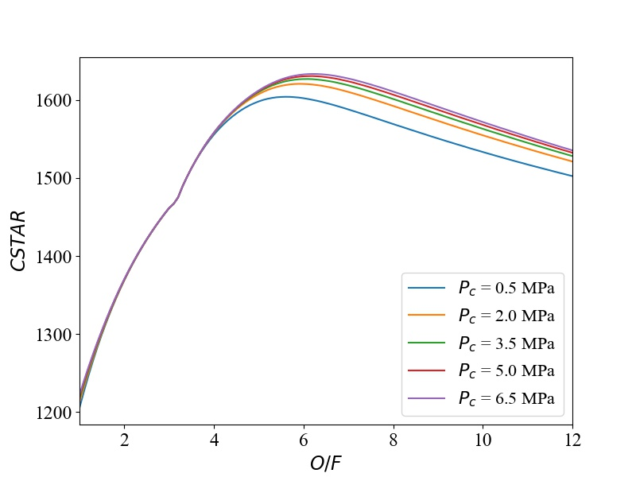
General Flight Characteristics
(Tentative)
F_{req} | 1570 N | Required Thrust
T_{C} | 3300 K | Chamber Temp.
O/F | 7 | Oxidizer-to-Fuel Ratio
P_{C} | 2 MPa | Chamber Pressure
c* | 1610 m/s | Characteristic velocity
γ | 1.148 | Specific heat ratio
I_{sp} | 219.3 s | Specific Impulse
C_{F} | 1.42 | Thrust Coefficient
ε | 4 | Nozzle expansion ratio
mdot_{ox} | 639 g/s | Oxidizer mass flow rate
mdot_{f} | 91.3 g/s | Fuel mass flow rate
Some of the parameters were computed by Chemical Equilibrium Application (CEA)

Slide 49
Presentation Items
Team Overview
Terpulence II
General Rocket Overview
Aero-Structures
Recovery/Avionics
Payload
Testing Plan
Hybrid Motor Development
Combustion Chamber
Fuel
Injector
Oxidizer

Slide 50
Combustion Chamber and Nozzle
Ignition Choice
Reusable Design
Cost efficient
Easily replaceable
Igniter material still TBD
Ematches - Will be needed to ignite main igniter
Black Powder - Easy to acquire and use, ignites solid fuel
Small Grain of Composite Solid Fuel- works for a longer period of time
Choice of Aluminum
Cheap and light
Required by spaceport (not frangible)
4 in Diameter
Easy to handle for our first rocket
Works for our goals
Phenolic Liner inside motor casing
Cheap and easy to work with, available for common casing sizes
Favorable thermal properties
Nozzle
Plan to purchase a nozzle because manufacturing with graphite is difficult and damaging to machines.

Slide 51
Presentation Items
Team Overview
Terpulence II
General Rocket Overview
Aero-Structures
Recovery/Avionics
Payload
Testing Plan
Hybrid Motor Development
Combustion Chamber
Fuel
Injector
Oxidizer

Slide 52
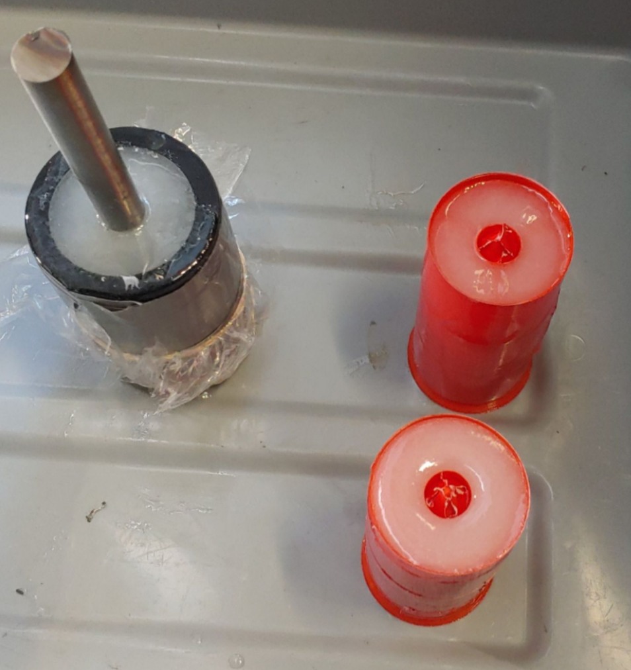
Fuel - Design and Development
Fuel Choice
HTPB, or Hydroxyl-terminated polybutadiene
Safe to store
Easy material to work with for manufacturing
Chosen over paraffin
Much higher regression rate which is desired
Extremely difficult to manufacture consistent grains with
Team manufacturing experience determined full scale paraffin fuel grains would not be possible after producing many small scale grains
Mold choice
Burn away mold
Ease of manufacturing
3D printed, allows for quick prototyping of new grain shapes
Bore Shape
Circular - control, where we plan to start our testing
Star - increased surface area, should increase regression rate

Slide 53
Fuel - Manufacturing and Test Plan
Manufacturing
Mold optimization - Aiming for single wall 3D printed molds
HTPB mixture verification, ensure mass ratio cures satisfactorily with no impurities
check by cutting open cured grains
Pour successful circular bore grains
Pour star shaped bore grains (or other higher surface area center through bore shapes)
Testing
Test burns with the circular bore grains and the high surface area grains
Compare performance
If higher regression rate is deemed necessary metal doping with aluminum micro particles has been researched
Further safety analysis will need to be done, some safety concerns have been raised due to aluminum particles residing in the fuel making the fuel no longer safe
Notes:
Possibly degas or shake to remove bubbles

Slide 54
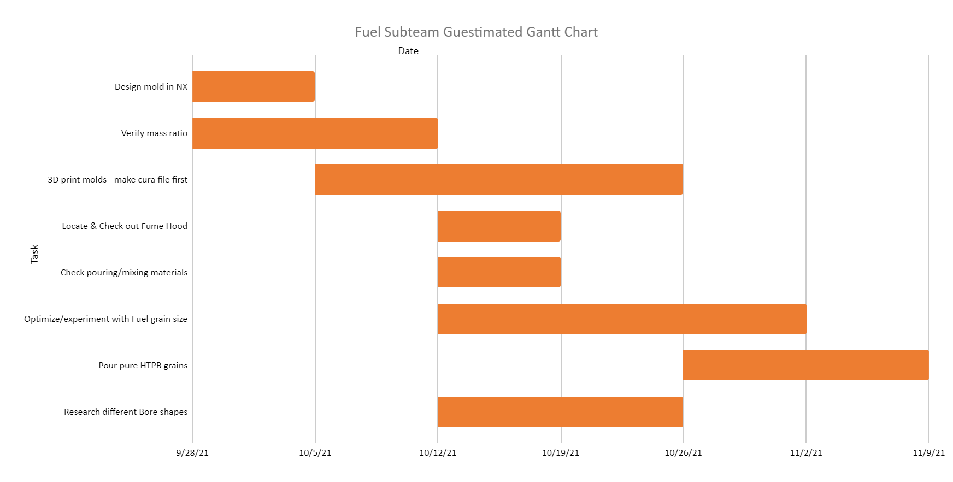
Fuel - Manufacturing and Test Plan

Slide 55
Presentation Items
Team Overview
Terpulence II
General Rocket Overview
Aero-Structures
Recovery/Avionics
Payload
Testing Plan
Hybrid Motor Development
Combustion Chamber
Fuel
Injector
Oxidizer

Slide 56
Injector - Design and Development
Ongoing trade study compared shower head, impinging, inclined, and vortex/swirl injectors
Shower head geometry is simple and deemed “out-of-date”
Vortex/swirl orifices were too complex for our manufacturing abilities
Inclined injectors could not be sufficiently supported by published literature
Impinging injector design was chosen. Two options:
Axial Impinging: Flow impinges onto a single focal point after injector
Self-Impinging: Flow impinges on local orifices’ flow
Axial impinging suits our desired burn
Resultant momentum vector will point directly down the center of the fuel grain
Notes:
Final.
Just build and test, injector will be mainly empirical.

Slide 57
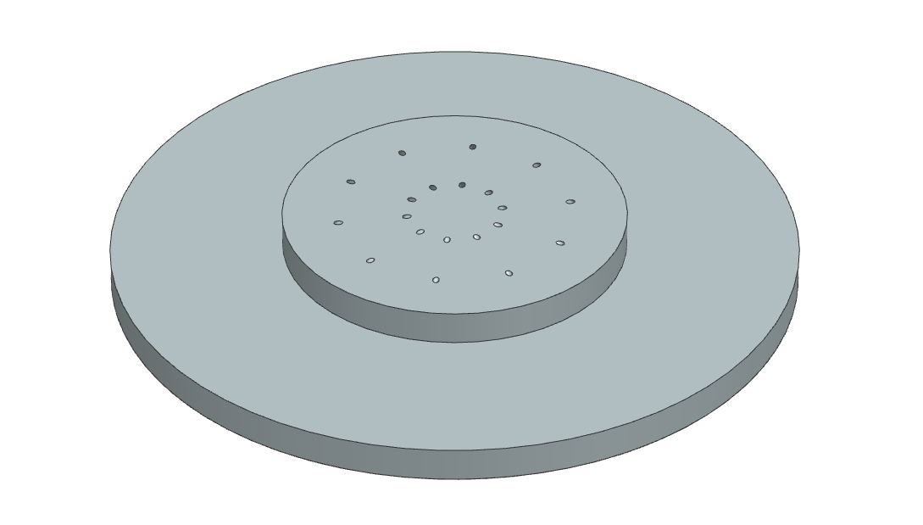
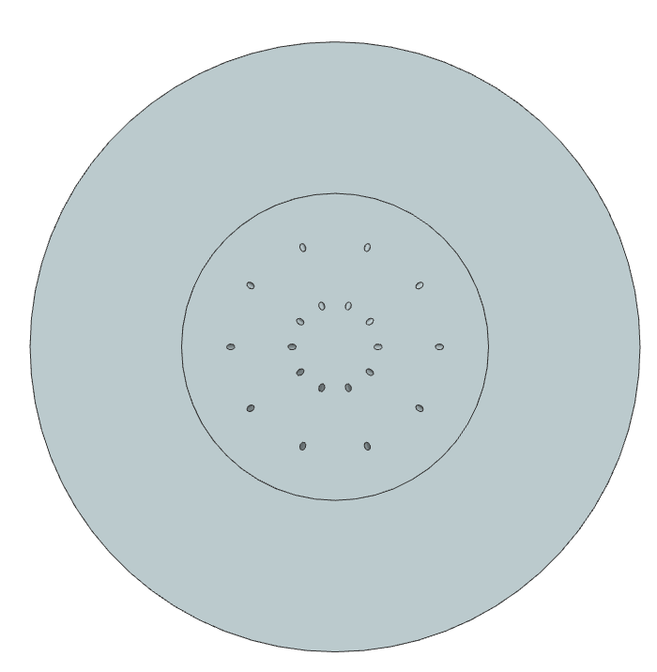
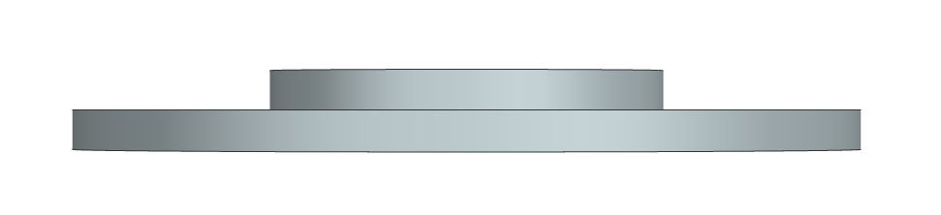
Injector - Preliminary CAD Images

Slide 58
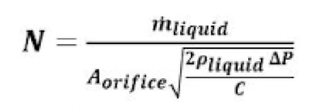
Injector - Design and Development
Important injector parameters:
Injector diameter
Orifice geometry
Influences discharge coefficient
Orifice area
Number of orifices
Orifice placement
Orifice angle
Resulting pressure drop
Focal point
Plate thickness
Oxidizer values (density, dynamic viscosity, mass flow rate, etc.)
Non-dimensional parameters:
Reynolds Number
Weber Number
Other important parameters:
Maximum atomized droplet size
Source: The Science And Design Of The Hybrid Rocket Engine ebook PDF | Downloa (melbhattan.com)
Notes:
-Might want orifice to be choked
-Going to have pressure fluctuations through combustion, not going to resonate; don’t want those fluctuations to affect the rest of the flow;
-Choked flow will help to prevent any possible issues

Slide 59
Injector - Test Plan
Experimental design for a cold-flow test is underway
Timeline currently places team getting one round of testing and resulting design iterations completed by the conclusion of the Fall 2021 semester
The Injector Team is currently learning NX FEA and Ansys CFD software to aid in testing process
Additional information:
A report is being drafted detailing design process of injector for future reference
Design freeze planned for 10/20/2021 to begin manufacturing process of first injector iteration
Expected iterations include:
Optimization of orifice placement
Optimization of orifice geometry and size
Notes:
Final.

Slide 60
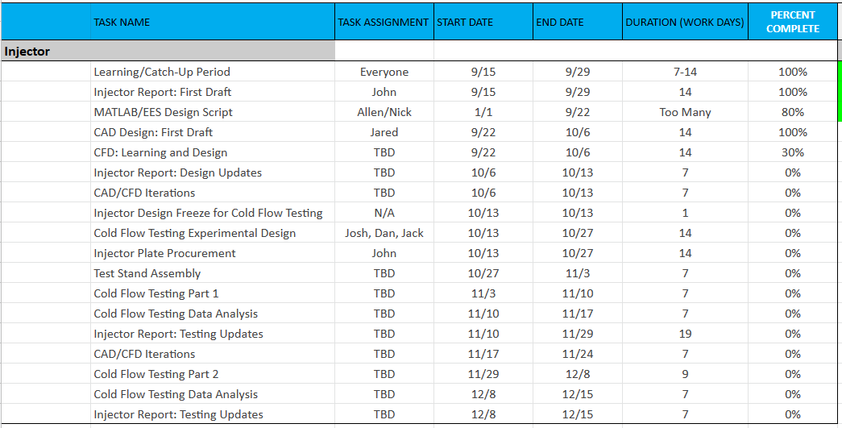
Injector - Test Plan
Notes:
Final.

Slide 61
Presentation Items
Team Overview
Terpulence II
General Rocket Overview
Aero-Structures
Recovery/Avionics
Payload
Testing Plan
Hybrid Motor Development
Combustion Chamber
Fuel
Injector
Oxidizer

Slide 62
Oxidizer
Oxidizer Selection
N2O, Nitrous Oxide
Widely available resource
Easy-to-handle
Slower erosion rate (compared to O2)
Self-pressurization capability*
Other choices
LOX, liquid oxygen
Not storable in room temperature
H2O2, hydrogen peroxide
Hazardous
Testing Plan
Plumbing system test
Valves
Cold-flow test
* currently investigating about the effect of two-phase flow at the injector
Testing Plan | Oct. | Nov. | Dec.
Research (General)
Design plumbing
Plumbing test
Cold-flow test

Slide 63

Questions?

